Slide 1
Wireless Network

Slide 2
Outline
Wireless Network
Types of Wireless Network Technologies
IEEE 802.11 Wireless Standard
Wireless Network Modes/Topology
Wireless Network Categories
Wireless Network Security Overview
Wireless Network Security Protocols
Wireless Networking Components
Securing Wireless Networks
Bridge Mode in Wireless Network

Slide 3
Wireless Network
A wireless network is a computer network that uses wireless data connections between network nodes.
Wireless networking allows homes, telecommunications networks and business installations to avoid the costly process of introducing cables into a building, or as a connection between various equipment locations
Wireless networks always have been targets for attackers
Early wireless networking standards had vulnerabilities
Hackers have found wireless networks relatively easy to break into, and even use wireless technology to crack into wired networks.
Wireless networks use Radio Frequency (RF) signals to connect wireless - enabled devices in the network
It uses IEEE standard of 802.11 and uses radio waves for communication

Slide 4
Wireless Network
Advantages
Disadvantages
Installation is easy and eliminates wiring
Access to the network can be from anywhere within the range of an access point
Public places like airports, schools, etc. can offer constant internet connection using wireless LAN
Wi-Fi Security may not meet the expectations
The bandwidth suffers with the number of users on the network
Wi-Fi standard changes may require replacing wireless components
Some electronics equipment can interfere with the Wi-Fi network

Slide 5
Wireless Technologies
Wi-Fi: Wi-Fi is a part of the IEEE 802.11 family of wireless networking standards. This technology uses radio waves or microwaves to allow electronic devices to exchange the data or connect to the Internet. Wi-Fi operates in the frequency band between 2.4 GHz to 5GHz.
Bluetooth: With Bluetooth technology data is transmitted between cell phones, computers and other networking devices over short distances. Signals transmitting from Bluetooth cover short distances compared to other modes of wireless communication i.e. up to 10 meters. Bluetooth transfers the data at less than 1Mbps and operates in the frequency range of 2.4 GHz. This technology comes under IEEE 802.15.
RFID (Radio-Frequency Identification): This technology uses radio frequency electromagnetic waves to transfer data for automatic identification and tracking tags attached to objects. RFID devices work within a small range, i.e. up to 20 feet.
Wi-Max: This technology uses long distance wireless networking and high-speed Internet. It belongs to the IEEE 802.16 family of wireless networking standards. WiMAX signals can function over a distance of several miles (30 miles or 50 km) with data rates reaching up to 75 Mbps. It uses a fixed wireless application and mobile stations to provide high-speed data, voice, video calls and Internet connectivity to users.

Slide 6
IEEE 802.11 Wireless Standards
IEEE 802: a committee responsible for LANs
IEEE 802.11: responsible for developing wireless protocols
Many standards
The Wi-Fi alliance: became popular with 802.11b
Wi-Fi Protected Access (WPA, WPA2)
Institute of Electrical and Electronics Engineers (IEEE)
Most influential organization for computer networking and wireless communications
Began developing network architecture standards in the 1980s
1997: Release of IEEE 802.11
Standard for wireless local area networks (WLANs)
Higher speeds added in 1999: IEEE 802.11b
Notes:
Wi-Fi(wireless fidelity.) Fidelity is the quality of faithfulness or loyalty.
Wi-Fi Protected Access is a security mechanism based on IEEE 802.11
Wi-Fi Protected Access (WPA), Wi-Fi Protected Access 2 (WPA2), and Wi-Fi Protected Access 3 (WPA3)

Slide 7
IEEE 802.11 Wireless Standards
IEEE 802.11a
Specifies maximum rated speed of 54Mbps using the 5GHz spectrum
IEEE 802.11g
Preserves stable and widely accepted features of 802.11b
Increases data transfer rates similar to 802.11a
IEEE 802.11n
Approve in 2009
Improvements in IEEE 802.11n
Speed
Coverage area
Interference
Security
Wireless client network interface card adapter
Performs same functions as wired adapter
Antenna sends and receives signals
Notes:
https://en.wikipedia.org/wiki/IEEE_802.11n-2009
Wi-Fi interference is any signal outside of the configured Wi-Fi network that weaken normal operation of the Wi-Fi network

Slide 8
IEEE 802.11 Wireless Standards
Evolution of Wi-Fi Standards:
“DSSS” stands for Direct Sequence Spread Spectrum.
“OFDM” stands for Orthogonal Frequency Division Multiplexing.
Protocol | Frequency | Bandwidth | Stream Data Rate (Mbits/s) | Modulation | Range (Indoor) | Range (Outdoor)
802.11b | 2.4 GHz | 20 MHz | Up to 11 | DSSS | 35-140 | 140-250
802.11a | 5 GHz | 20 MHz | Up to 54 | OFDM | 35-120 | 120-300
802.11g | 2.4 GHz | 20 MHz | Up to 54 | OFDM/DSSS | 38-140 | 140-250
802.11n | 2.4/5 GHz | 20/40 MHz | Up to 600 | OFDM | 70-250 | 250-600
Notes:
https://en.wikipedia.org/wiki/IEEE_802.11n-2009
Wi-Fi interference is any signal outside of the configured Wi-Fi network that weaken normal operation of the Wi-Fi network

Slide 9
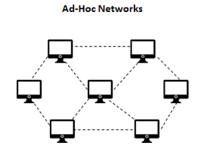
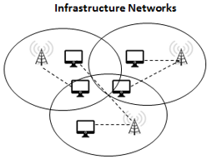
Wireless Network Modes/Topology
Ad-hoc Mode
Infrastructure Mode
Each wireless client connects directly with each other
No central device managing the connections
Rapid deployment of a network where no infrastructures exist
Each node must maintain its proper authentication list
Each wireless client connects directly to a central device called Access Point (AP)
No direct connection between wireless clients
AP acts as a wireless hub that performs the connections and handles them between wireless clients

Slide 10
Wireless Network Categories
Wireless networks are classified based on the connection used and the geographical area.
Wireless networks are classified into WLAN, WPAN, WWAN, and WMAN based on the area they cover geographically.
WLAN (Wireless Local-Area Network)
It that connects users in a local area with a network. The area may range from a single room to an entire campus.
WPAN (Wireless Personal Area Network)
It interconnects devices positioned around an individual, in which the connections are wireless. WPAN has a very short range. It can communicate within a range of 1.0 meters. For example, Bluetooth.
WWAN (Wireless Wide-Area Network)
It covers an area larger than the WLAN. It handles cellular network technology such as CDMA, GSM, GPRS, and CDPD for data transmission. This technology may cover a particular region, nation, or even the entire globe.
WMAN (Wireless Metropolitan-Area Network)
WMAN covers a metropolitan area such as an entire city or suburb. It accesses broadband area networks by using an exterior antenna. In a WMAN, the subscriber stations communicate with the base station that is connected to a central network or hub. A WMAN uses a wireless infrastructure or optical fiber connections to link the sites.

Slide 11
Wireless Network Security Overview
Concerns for wireless security are similar to those found in a wired environment
Security requirements are the same:
Confidentiality, integrity, availability, authenticity, accountability
Most significant source of risk is the underlying communications medium
Key Risk Factor
Channel: broadcast communication (more sensitive to eavesdropping and jamming)
Mobility: Additional risks
Resources: Advanced OS (iPhone, Android), but limited resources (memory, processing)
Accessibility: Certain devices may be left unattended

Slide 12
Wireless Network Security Protocols
Security Protocol | Encryption | Authentication | Key Management | Vulnerabilities
WEP (Wired Equivalent Privacy) | WEP uses RC4 stream cipher with 40/64-bit or 104/128-bit keys. | Uses basic shared key authentication (pre-shared keys). | Static, manually configured keys. | Vulnerable to various attacks like packet sniffing, key cracking, and replay attacks due to weak encryption and static keys.
WPA (Wi-Fi Protected Access) | WPA uses TKIP encryption with 128-bit keys. | Uses 802.1X/EAP for authentication or pre-shared keys (PSK). | Dynamic key management with TKIP. | Provides improved security over WEP but still vulnerable to attacks like brute-force dictionary attacks.
WPA2 | WPA2 uses AES-CCMP encryption with 128-bit keys. | Supports both 802.1X/EAP and PSK authentication. | Dynamic key management with AES-CCMP. | Offers significantly enhanced security compared to WPA, resistant to many attacks due to stronger encryption algorithms.
Open | No encryption (data is sent in plaintext). | No authentication required; anyone can connect. | No key management as there are no keys. | Completely insecure as data is transmitted without encryption, making it susceptible to eavesdropping and other attacks.
Notes:
TKIP stands for Temporal Key Integrity Protocol.
AES-CCMP stands for Advanced Encryption Standard - Counter Mode with Cipher Block Chaining Message Authentication Code Protocol.

Slide 13
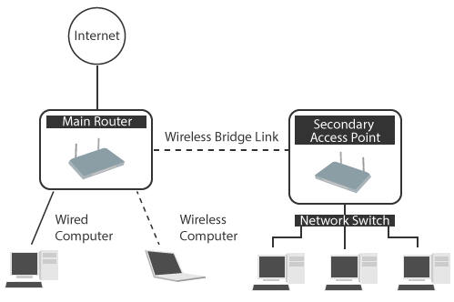
Wireless Networking Components
Point of Attack
Wireless client: WIFI-enabled laptop/tablet, cell phone, Bluetooth device, …
Access point: Cell towers, WIFI hotspots, wireless routers
Transmission medium: carries signals
Access Point
Antenna and radio transmitter/receiver send and receive wireless signals
Bridging software to interface wireless devices to other devices
Wired network interface allows it to connect by cable to standard wired networks

Slide 14
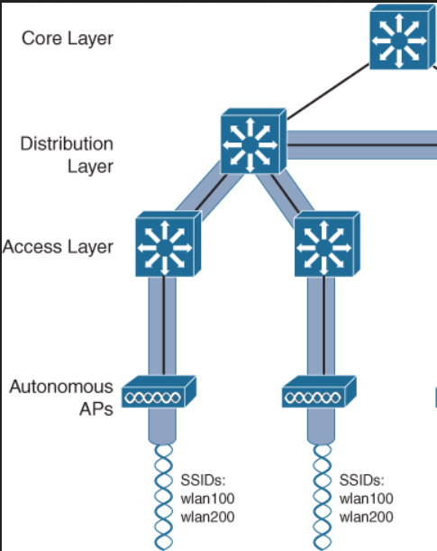
Wireless Networking Components
AP functions
Acts as “base station” for wireless network
Acts as a bridge between wireless and wired networks
Can connect to wired network by a cable
Instead of running cable between the two buildings, which is more expensive, two outdoor access points have been configured for wireless mesh.
Autonomous access points
All APs were Autonomous mode, which means that each AP worked as a standalone unit with no knowledge of or interaction among other APs.
APs are connected to the same network, and may use the same SSID, they are all individually configured and separate from one another.
Have necessary “intelligence” for wireless authentication, encryption, and management
Notes:
SSID stands for Service Set Identifier
The SSID (Service Set Identifier) is the name of your wireless network, also known as Network ID. This is viewable to anyone with a wireless device within reachable distance of your network.

Slide 15
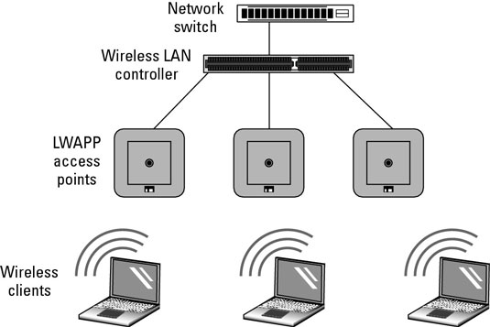
Wireless Networking Components
Lightweight access points
Rather than using Autonomous mode APs, you can use Lightweight mode APs if you have a network component that offers Wireless LAN Controller services.
Wireless broadband routers
Single hardware device containing AP, firewall, router, and DHCP server
Notes:
lightweight access point:
there are a couple of protocols that you might run into … that are used to communicate … between the wireless LAN controller and the APs. … The first protocol is LWAPP. … That stands for Lightweight Access Point Protocol. … However, that's an older protocol, … it's becoming less popular in favor of CAPWA
CAPWAP (Control and Provisioning of Wireless Access Points) is a protocol that enables an access controller to manage a collection of wireless termination points.P. … That stands for Control and Provisioning … of Wireless Access Points. …

Slide 16
Securing Wireless Networks
Use encryption
Apply MAC-filtering
Use and enable anti-virus, anti-spyware, firewall
Turn off SSID broadcasting
Change default identifier on router
Change router’s present password

Slide 17
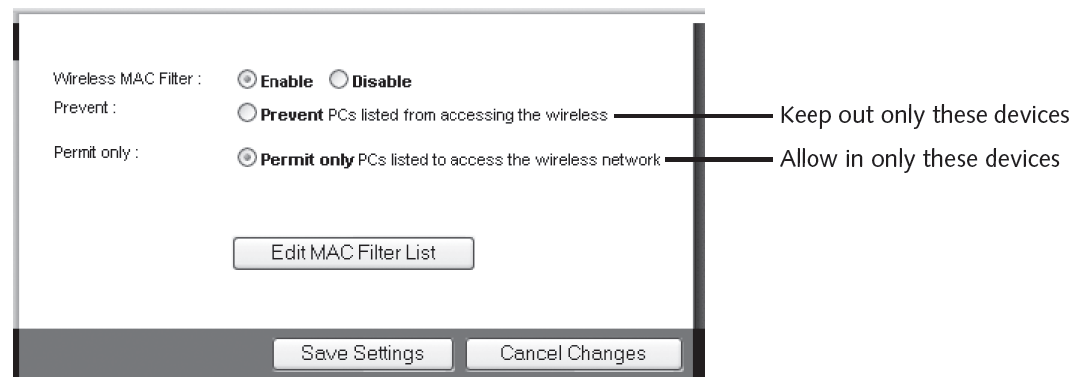
MAC Address Filtering
Apply MAC Filtering
Method of controlling WLAN access
Limit a device’s access to AP
Media Access Control (MAC) address filtering
Used by nearly all wireless AP vendors
Permits or blocks device based on MAC address
Vulnerabilities of MAC address filtering
Addresses exchanged in unencrypted format
Attacker can see address of approved device and substitute it on his own device
Managing large number of addresses is challenging

Slide 18
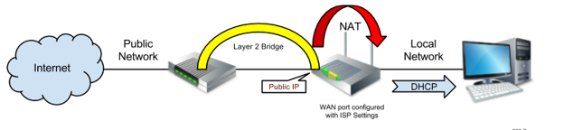
Bridge Mode in Wireless Network
In a wireless network, Bridge mode allows a device, such as a wireless access point or router, to act as a bridge between two separate network segments.
It forwards traffic between the segments transparently, essentially extending the network without creating separate subnets.
Bridge mode is commonly used to expand wireless coverage without introducing additional network complexity or IP address conflicts.

